Slide 1
The Geological Compass

Slide 2
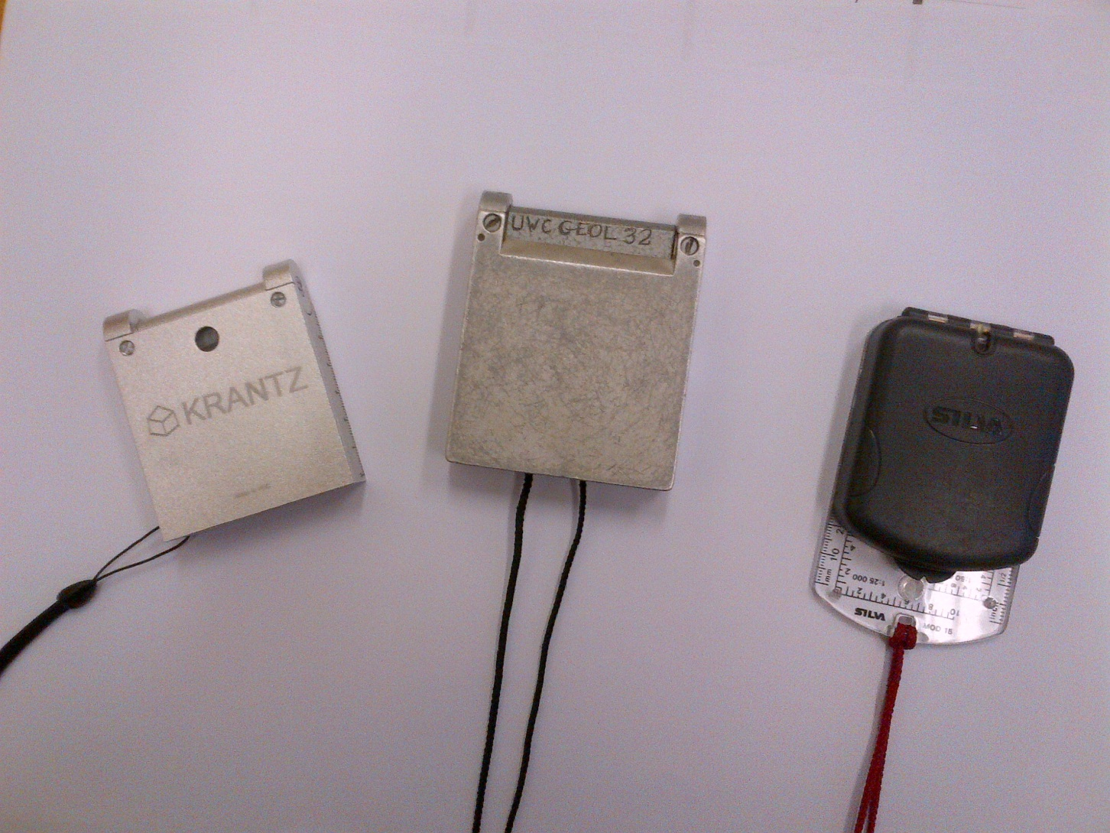
Krantz, Freiberger and Silva compasses

Slide 3
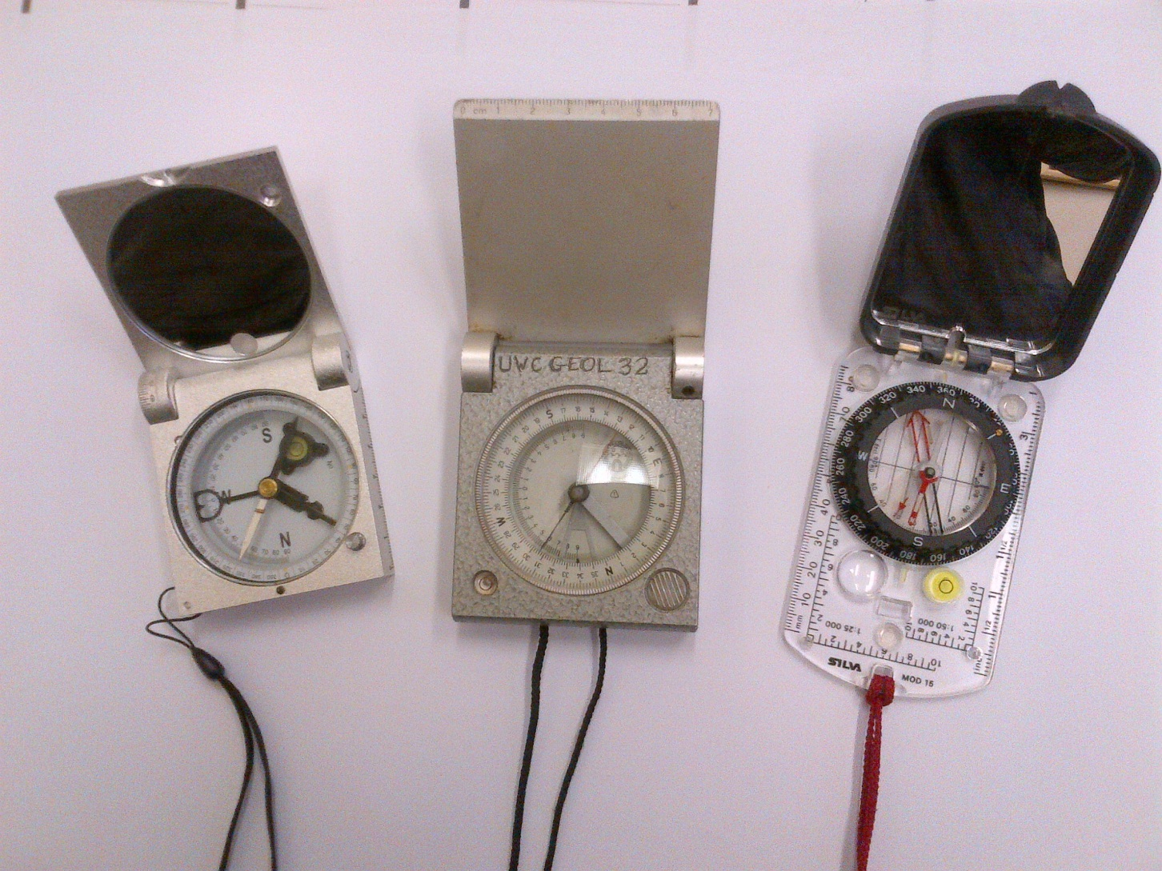
Compasses at UWC

Slide 4
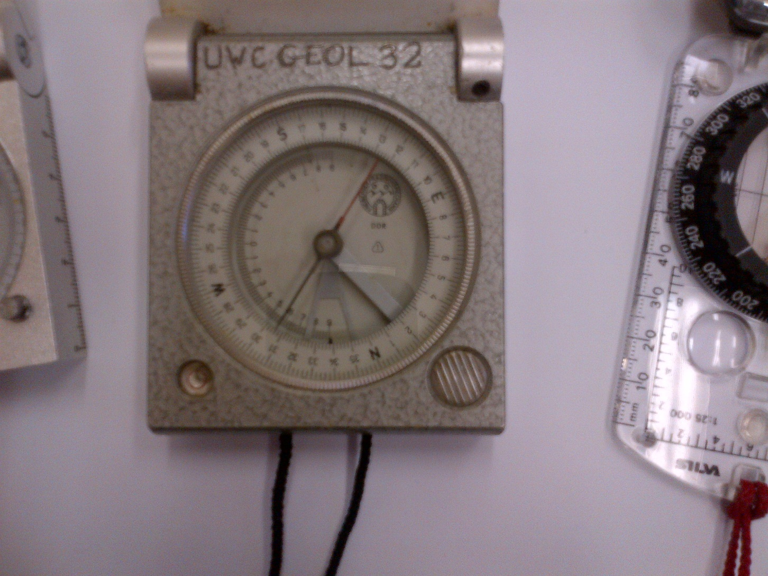
Freiberger compass

Slide 5
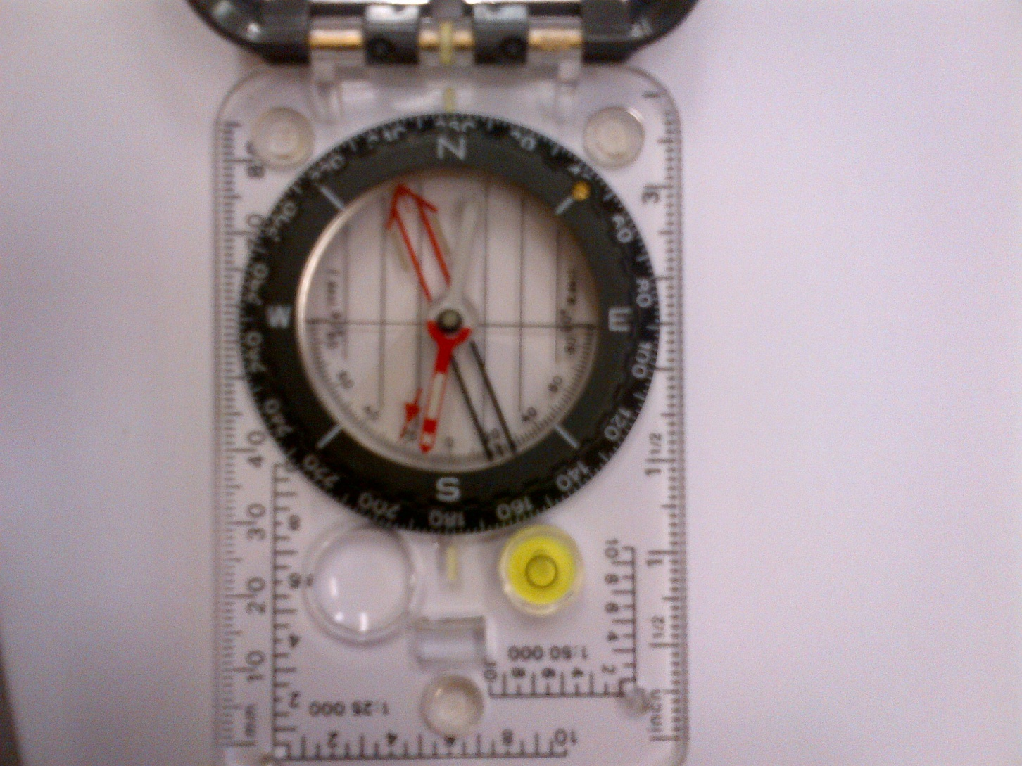
Silva compass

Slide 6
Why Measure?
Geology works with a 4-D model: Time and the usual 3 dimensions. This means that we need to get the three dimensions from our field records and this is structural geology
Describing the orientation of geological structures is therefor the basis of structural geology.
Despite the advent of digital techniques, the magnetic compass remains the most practical, simple and commonly used instrument to record orientations in the field, and every geologist needs to become thoroughly proficient in the use of the compass.

Slide 7
What to measure
The orientation of planar and linear features
For Planar features you measure the direction of dip (also called “dip azimuth”) and dip
Linear features you measure the trend and plunge of the linear feature

Slide 8
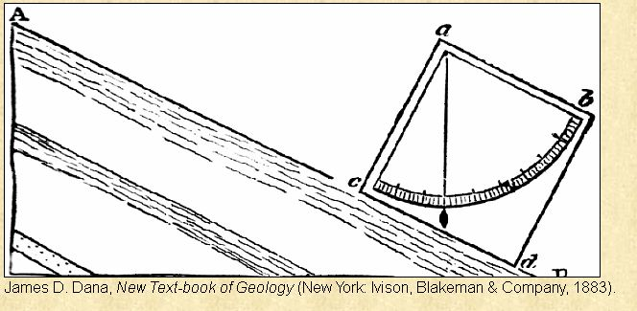
Dip

Slide 9
Dip
The dip is the angle of maximum inclination on the plane

Slide 10
STRIKE
The strike is the direction of any and all horizontal lines on a plane. Every inclined plane will contain an infinite number of strike lines, each of them different distances above or below a horizontal datum.
All strike lines on that plane must therefore be parallel to each other. That is, all strike lines of a plane will have the same bearing or orientation in space. That is why we can define a single strike for any plane.

Slide 11
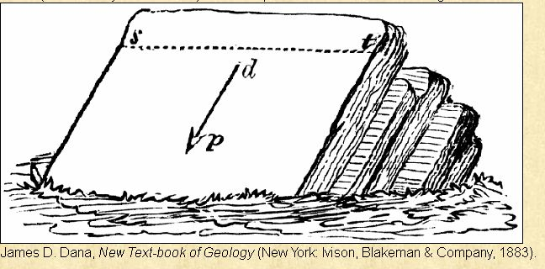
Strike, here shown as the dotted line; dip is indicated by the arrow

Slide 12
DIP / Direction of Dip
The dip is the angle of maximum inclination on the plane.
The direction of the dip is necessarily perpendicular to the strike line. As with a plunge, we always measure the dip downward from horizontal.
The value of the dip varies from 0 to 90. So, a horizontal book has a dip of 0, a vertical book has a dip of 90, a book that is oriented halfway between these end-members has a dip of 45, etc.

Slide 13
Azimuth
An azimuth is one way of designating a direction, or bearing, on a horizontal plane, in space .
We use the geographic North pole, the point where the Earth’s axis of rotation intersects its surface, as our reference for reckoning directions. We call the direction along which one would need to travel to reach the geographic North pole ‘North.’

Slide 14
Azimuth - 2
Azimuths range from 0 (North) to 360 (also North), read in a clockwise fashion.
Consequently, 090 is East, 180 is South, and 270 is West. Note that we use 3 digits (002, 087, 120 etc.) to define an azimuth and that we drop the degree (º) sign. North is always toward the top of the page on maps. Azimuths are commonly used by navigators of all sorts, but particularly by sailors who are unconstrained by obstacles and can go in any direction.

Slide 15
Magnetic declination
The axis of Earth’s magnetic field does not coincide with Earth’s rotation axis, so the magnetic North pole does not coincide with the geographic North pole. In addition, the magnetic North shifts over time.
Because the compass always points to the magnetic North pole, there is at most locations on Earth an angular difference, called the magnetic declination between the direction in which the compass needle points and geographic North.

Slide 16
Declination
The magnetic declination is the angle, measured in a horizontal plane, between the direction towards the geographic North pole and the direction to the magnetic North pole. A declination of 10° west means that the magnetic North pole is oriented 10° west of north (i.e. counter clockwise) from the geographic North pole. The declination differs from one geographic position to the other so must always be checked.

Slide 17
Adjustment of compass
As the magnetic declination differs from place to place, we need to establish its value at the place we will use the compass and adjust the compass accordingly or, if that is not possible, adjust the readings according to the local magnetic declination. This adjustment is critical as it can be more than 20 degrees at several places.

Slide 18
Adjustment of compass
The Krantz and Freiberger have a little screw that allows us to adjust the declination.
The Sylva has a little bronze screw in the black ring and a pointed tool at the long string that fits the screw to move the red arroe until it points at the correct number of degrees W of N.

Slide 19
Trend
We use two numbers to describe the orientation of a linear element or lineation in space:
Trend and plunge
The trend (also called the plunge bearing ) is the angle between a line, or its projection onto the horizontal plane (what you would see when looking vertically down on the linear element from above), with respect to North, measured in a clockwise manner.

Slide 20
Trend/ plunge
We usually give the trend as an azimuth, varying from 000 to 360, and always written with three numbers (e.g., 005). For example, if you place a pencil on the ground, with the point oriented toward N, the linear element (i.e. pencil) would have a trend of 000. If the pencil were oriented NE, it would have a trend of 045.

Slide 21
Plunge
The plunge (or inclination) of any linear element is the angle measured downward from the horizontal to the line in a vertical plane. That vertical plane is oriented in the direction of the trend

Slide 22
Plunge
The plunge is the deviation from the horizontal in the vertical plane that contains the linear element. The value of the plunge varies from 0 to 90. So, a pencil that is oriented horizontally has a plunge of 0, a pencil that is oriented vertically has a plunge of 90, a pencil that is oriented halfway has a plunge of 45. In structural geology, the plunge is always downward into the Earth.

Slide 23
Annotation
15 125 means a plane that dips 15 degrees towards the SE ie 125 degrees from North. This the dip/direction of dip annotation
15/125 is the annotation for plunge/trend of a line.
Please note that the plunge/trend annotation as shown for a linear feature is often also used for planes. It thus critical to indicate clearly what your annotation represents.

Slide 24
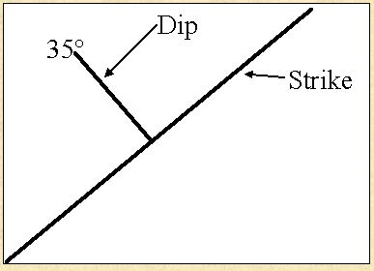
Map Symbols

Slide 25
How to measure a planar feature-1
Adjust the magnetic declination
Put the lid of the compass firmly on the plane and manoevre it together with rotation along the hinge line, until the bubble is central in the ring. This is necessary for the needle to be able to move
Note that the hinge is now parallel to the strike line. Mark its orientation with e.g., a pencil
When the needle stops moving, lock its movement (on the Freiberger and Krantz compasses by pressing or releasing the brake button) but on the Silva and the Brunton compasses turn the dial until the red arrow coincides with the red needle

Slide 26
How to measure a planar feature-2
5 Read the orientation of the red needle when the angle between the lid and the compass is >90 degrees ie the lid is open on all compasses. Use the white needle if the angle is <90 degrees. On all compasses read it at the mark on the hinge side of the compass, if the angle between Lid and compass is <90 degrees. If that angle is >90 degrees read it on the mark at the bottom of the dial. Some Brunton compasses have a little window at the bottom with both readings. Choose the correct one, ie know roughly where North is and thus in which direction it is dipping as the numbers in the window are 180 degrees apart.

Slide 27
How to measure a planar feature-3
6 In the case of the Freiberger and Krantz, the dip is shown at the hinge on the outside of the compass.
7 On the Silva and Brunton you have a different method to obtain the dip
On the round dial you see that one half has numbers on the inside of the circular dial. Turn the dial in such a way that the half circle of numbers is parallel to the side of the compass.
Put that side on the rock perpendicular to the strike mark you made earlier
Read the number pointed at by the little red arrow – this the amount of dip. You may have to gently tilt the compass to lie “on its back” without moving the red arrow, to be able to read it off

Slide 28
How to measure a linear feature
Use the edge of the lid and put it firmly against the rock on the linear feature
Manoevre the compass by using the edge on the rock as an axel to swivel the whole compass while using the hinge line to move the compass part up and down until the bubble is in the circle, all while keeping the edge on the linear feature
You can now read on the Brunton and Krantz, but on Silva and Brunton you can now turn the dial until the red arrow coincides with the red needle, after which you can read the trend
You can can measure the dip in the same way as for planar features

